Slide 1
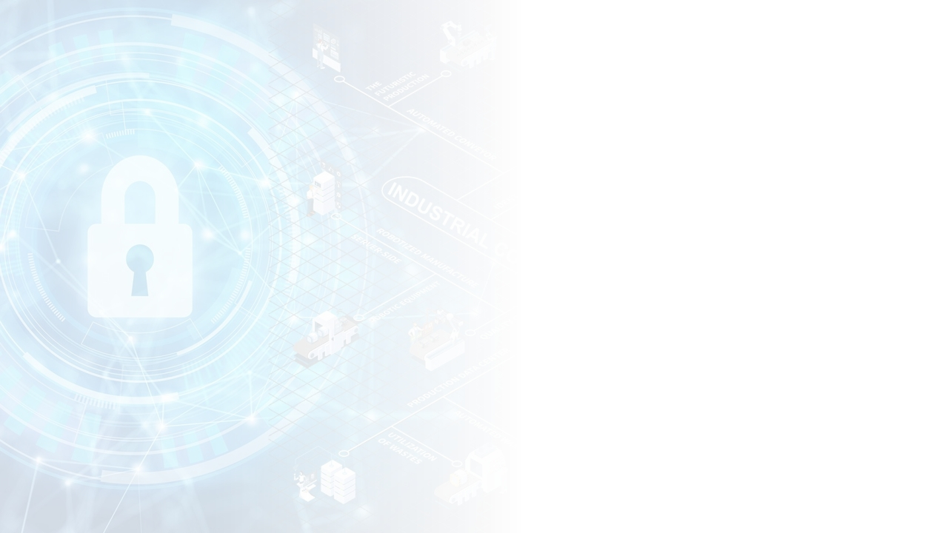
Overview of
Control Systems
We'll look at things like Distributed Control Systems and Programmable Logic Controllers. We'll also talk about SCADA, which helps oversee processes, Building Automation for efficiency, Safety Instrumented Systems for safety, and how the Industrial Internet of Things (IIOT) is integrated.

Slide 2

Module 1: Course
Introduction
Module 2: Overview
of Control Systems
Module 3: Cyber
Security Introduction
Module 4: IEC 62443
Foundational
Requirements
Module 5: Cyber
Security In-Depth
Module 6: Course
Close Out

Slide 3
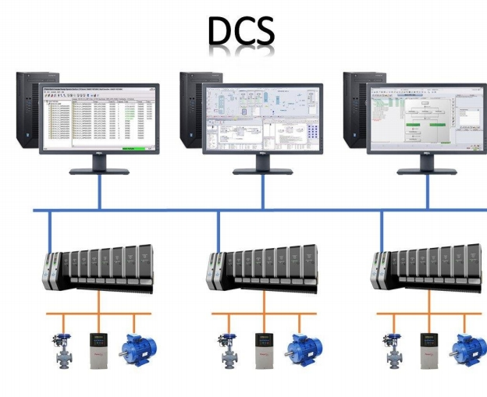
What is a or Distributed Control System (DCS)?
DCS refers to a control system where the control functions
are distributed rather than
centralized on a single
controller or algorithm. This
distributed nature allows for
the placement of multiple
controllers and automation
systems across a large
geographical area, which in
turn enables centralized monitoring and control from a single console or operator
workstation.

Slide 4
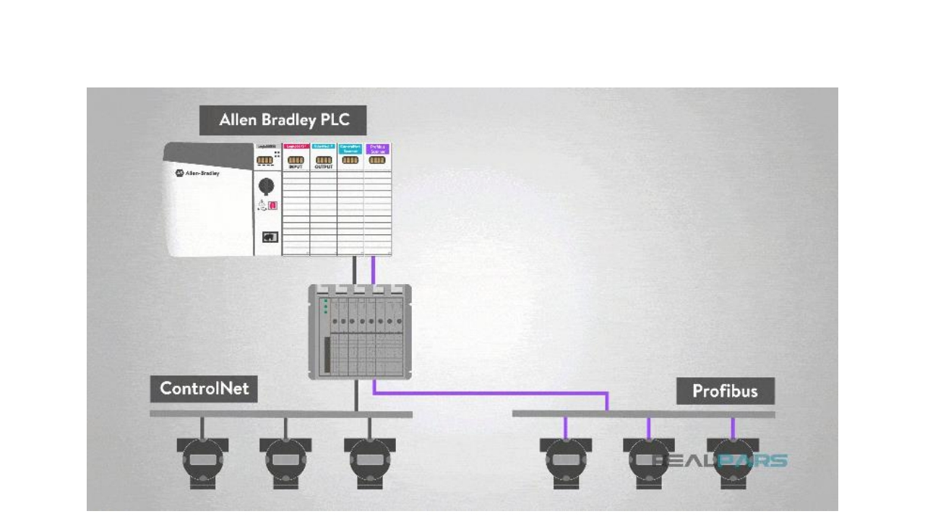
Programmable Logic Controllers

Slide 5
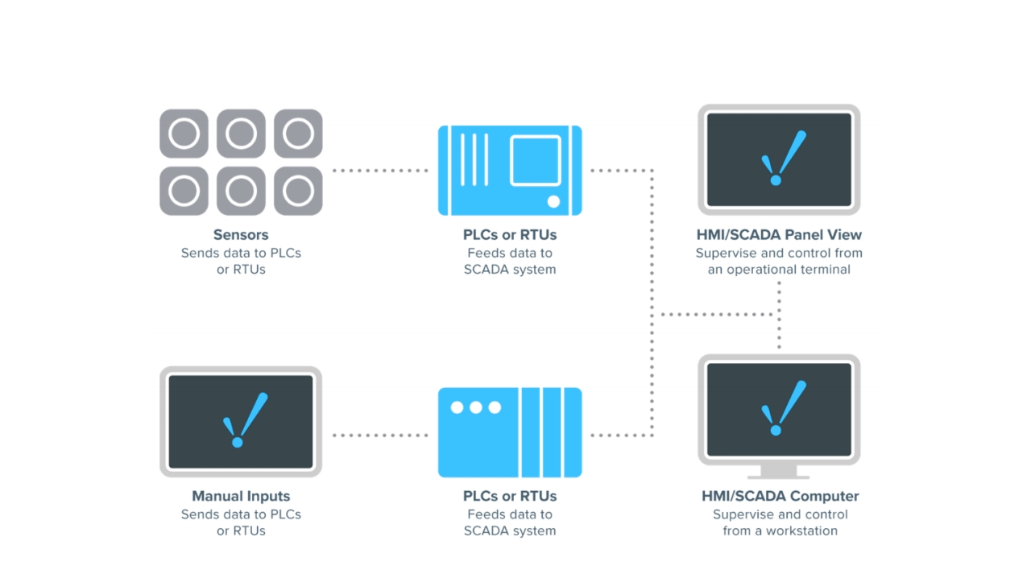
SCADA Explained

Slide 6
SCADA Explained

Slide 7
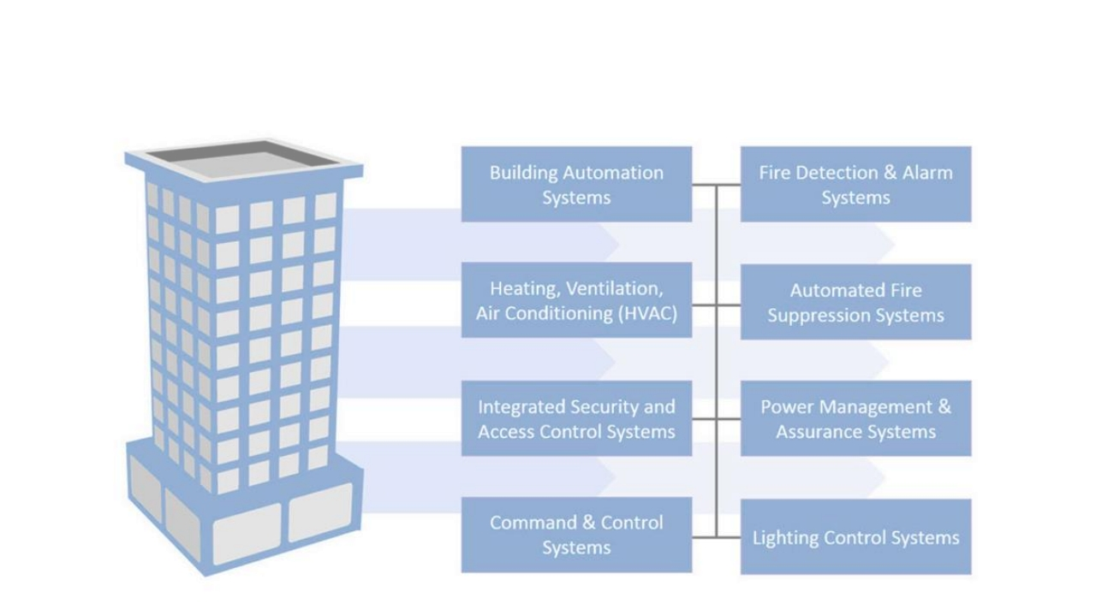
Building Automation and Control System Overview

Slide 8
Building Automation and Control System Overview

Slide 9
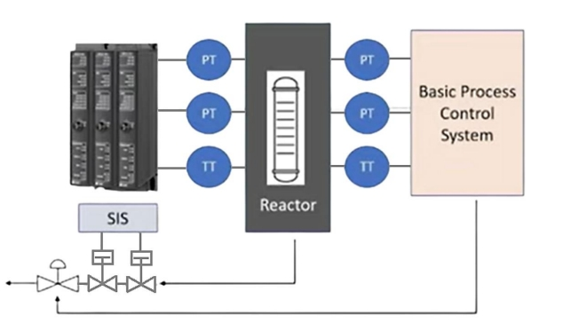
Safety Instrumented Systems (SIS) Overview
What is SIS? SIS stands for Safety Instrumented System. These systems are the unsung heroes of industrial safety, designed to reduce the likelihood or consequences of hazardous situations by bringing the system to a safe state when needed.

Slide 10
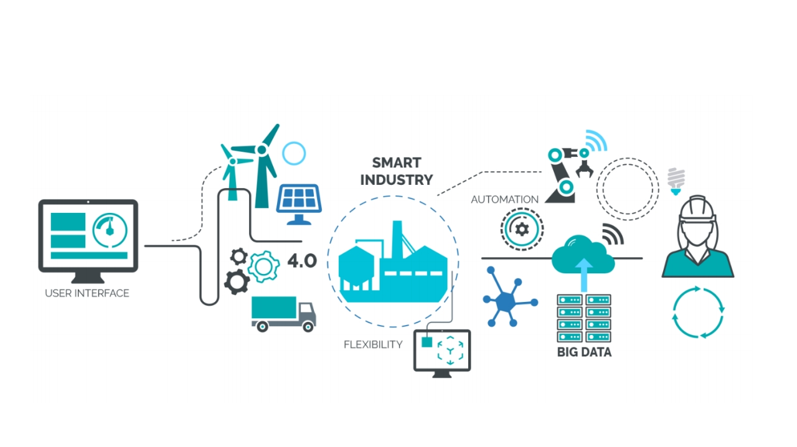
Industrial Internet of Things

